Slide 1
Entity-Relationship Diagrams
Mapping tables

Slide 2


In this video...

Slide 3

All about relationships

Slide 4
Definitions
Cardinality: the maximum number of entities allowed in the relationship
One or many
Modality: the minimum number of entities allowed in the relationship
Zero or one (optional or mandatory)

Slide 5




Crow's foot notation
Relationships are diagrammed using crow's foot notation
Cardinality | Modality | Notation
One | Optional
One | Mandatory
Many | Optional
Many | Mandatory

Slide 6

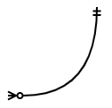
Crow's foot notation
Relationships are bidirectional
A relationship line must have the crow's foot notation on both ends of the line
Each end must express cardinality and modality
Cardinality is shown at the end of the line
Modality is shown just inside the end

Slide 7
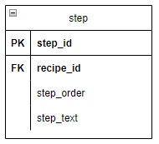
ERD conventions
Primary key columns are above the line and are designated with PK
Foreign key columns are below the line and are designated with FK
The line

Slide 8
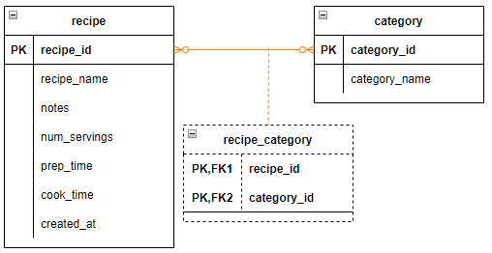
Join tables
Shown with dashes off the main relationship

Slide 9
Naming conventions - columns
Table names and column names are lowercase with words separated by underscores
Common names should have the table name prepended
Table recipe, col name: recipe_name

Slide 10
Naming conventions - relationships
Primary key columns are formed by adding "_id" onto the table name
Table recipe: recipe_id
Table ingredient: ingredient_id
Foreign key columns are named the same as the primary key column in the related table
Table recipe (primary key): recipe_id
Table step (foreign key): recipe_id

Slide 11

Building the project

Slide 12
Building the project
Video project: Create an Entity-Relationship Diagram using draw.io

